Slide 1
PHYS 304: Lecture 13 (Intro to) Quantum Mechanics
Sept-Dec 2021 Edition
Jeff Young
brimacombe Rm 278, young@phas.ubc.ca

Slide 2
Housekeeping
Thank you Arnab!
Please complete the posted Mid Course Survey.
Anonymous
We will listen!
How many people are at least vaguely familiar with Python programming?

Slide 3
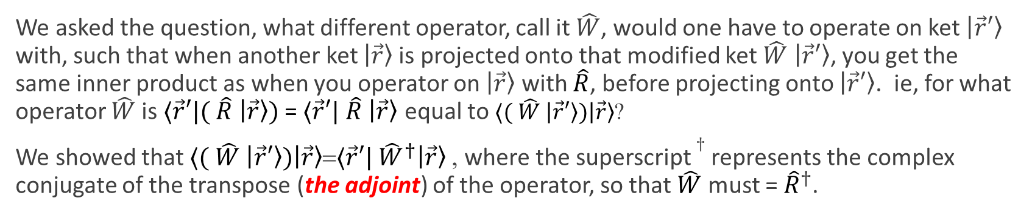
Review of key points from last lecture
We asked the question, what different operator, call it $\hat{W}$, would one have to operate on ket $\left|\vec{r}′\right\rangle$ with, such that when another ket $\left|\vec{r}\right\rangle$is projected onto that modified ket $\hat{W}$ $\left|\vec{r}′\right\rangle$, you get the same inner product as when you operator on $\left|\vec{r}\right\rangle$ with $\hat{R}$, before projecting onto $\left|\vec{r}′\right\rangle$. ie, for what operator $\hat{W}$is $⟨\vec{r}′|($ $\hat{R}$ $\left|\vec{r}\right\rangle )$ = $⟨\vec{r}′|$ $\hat{R}$ $\left|\vec{r}\right\rangle$ equal to $⟨($ $\hat{W}$ $\left|\vec{r}′\right\rangle )\left|\vec{r}\right\rangle$?
We showed that $⟨($ $\hat{W}$ $\left|\vec{r}′\right\rangle )\left|\vec{r}\right\rangle$=$⟨\vec{r}′|$ ${\hat{W}}^{†}\left|\vec{r}\right\rangle$, where the superscript $†$ represents the complex conjugate of the transpose (the adjoint) of the operator, so that $\hat{W}$ must = ${\hat{R}}^{†}$.
i.e. $⟨\vec{r}′|($ $\hat{R}$ $\left|\vec{r}\right\rangle )=⟨({\hat{R}}^{†} \left|\vec{r}′\right\rangle )\left|\vec{r}\right\rangle$ because $⟨({\hat{R}}^{†} \left|\vec{r}′\right\rangle )|=⟨\vec{r}′|$ $\hat{R}$
Notes:
Show the 2D graph sanity check from last day again here.

Slide 4


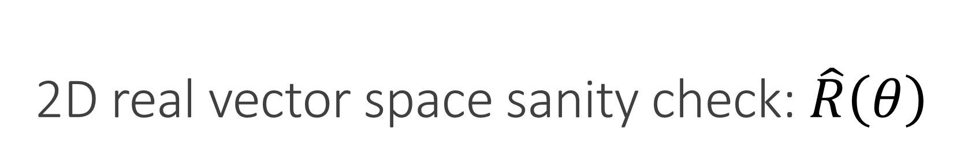
2D real vector space sanity check: $\hat{R}\left(θ\right)$
$${\hat{R}(Θ)}^{†}={\hat{R}(Θ)}^{T}=\hat{R}(−Θ)$$
Notes:
Do this on Tablet
POLL: Which of the following is valid representation of the mirror reflection through the y-axis operator? Matrix1, Matrix 2, projection expansions of M1 and M2

Slide 5



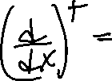






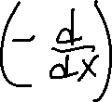




Review of key points from last lecture
Notes:
NOTE: direct analogy to the 2D vector space example, if think in terms of matrix representations, BUT ADD THE NEED TO TAKE COMPELEX CONJUGATE WHEN EVALUATING THE INNER PRODUCT, NOT JUST THE TRANSPOSE OF THE VECTOR THAT IS BEING PROJECTED FROM THE LEFT. I.E. <\vec r’|\vec r>= [x’*,y’*]$\left[\begin{matrix}x \\ y\end{matrix}\right]$]

Slide 6
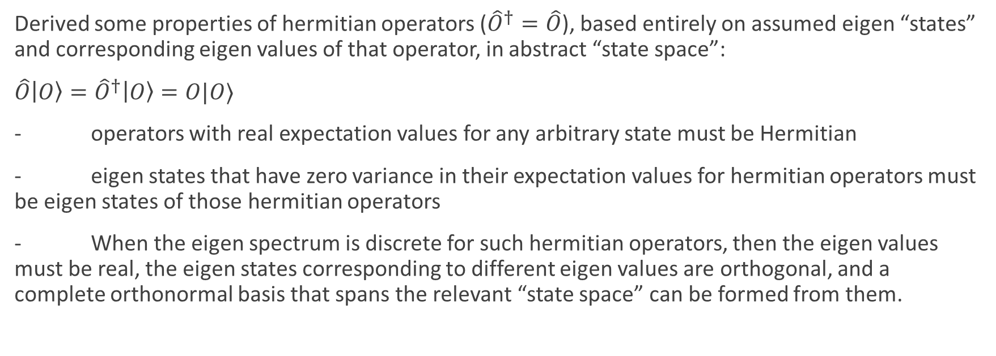
Review of key points from last lecture
Derived some properties of hermitian operators (${\hat{O}}^{†}=\hat{O}$), based entirely on assumed eigen “states” and corresponding eigen values of that operator, in abstract “state space”:
$\hat{O}\left|O\right\rangle ={\hat{O}}^{†}\left|O\right\rangle =O|O⟩$
- operators with real expectation values for any arbitrary state must be Hermitian
- eigen states that have zero variance in their expectation values for hermitian operators must be eigen states of those hermitian operators
- When the eigen spectrum is discrete for such hermitian operators, then the eigen values must be real, the eigen states corresponding to different eigen values are orthogonal, and a complete orthonormal basis that spans the relevant “state space” can be formed from them.

Slide 7
Today
Reinforce the immutable nature of quantum mechanical “states” and operators that exist in a system’s Hilbert space
Put what we have done so far in the course, all in terms of differential operators in 1 dimensional x space, in this larger context of abstract Hilbert space

Slide 8
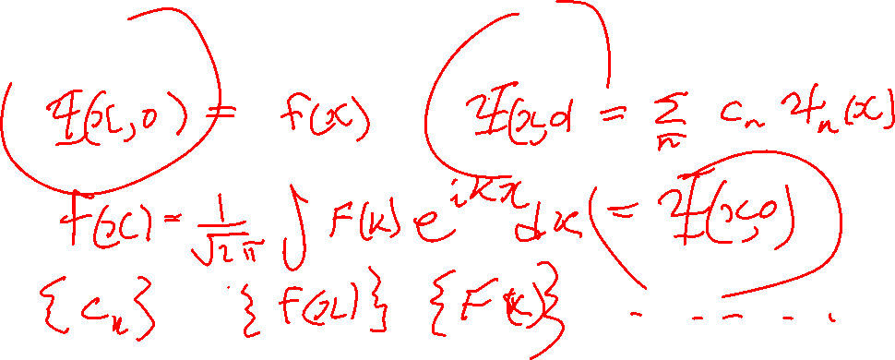
Lecture 13, Activity 1:
What are 3 ways you already know of to specify $Ψ\left(x,t\right)$ at some specific time $t$, say $t$=0 ?
Notes:
Recall we discussed previously that you can expand psi(x,t=0) in terms of the stationary eigen states of the total energy operator, \psi_n, which we were told form a complete orthonormal set of functions, that can be used to expand/represent any square integrable function in x, with the inner-product defined as \int (psi_n*(x) f(x) dx. Previously you have been told that you can expand an arbitrary square integrable function in terms of a Fourier series or Fourier transform, with the same inner product rule, where there \psi_n(x)=exp^(-ikx). So this is sort of like having different bases, $\left|\hat{α1}\right\rangle$and $\left|\hat{α2}\right\rangle$, in 2D real vector space,
Write down expansions of \Psi(x,0)

Slide 9
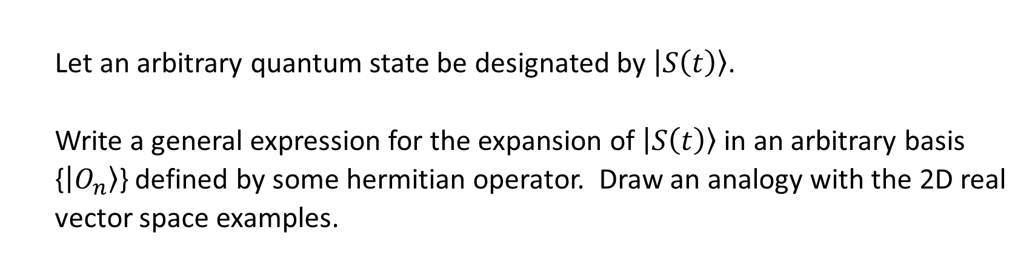
Lecture 13, Activity 1:
Thus there must be some immutable state that represents the essence of a quantum mechanical particle’s temporal evolution, subject to some potential. That state can be fully described using any number of expansions in distinct bases that each span the more general Hilbert state space of the problem.
Let an arbitrary quantum state be designated by $\left|S\left(t\right)\right\rangle$.
Write a general expression for the expansion of $\left|S\left(t\right)\right\rangle$ in an arbitrary basis {$\left|O_{n}\right\rangle$} defined by some hermitian operator. Draw an analogy with the 2D real vector space examples.

Slide 10
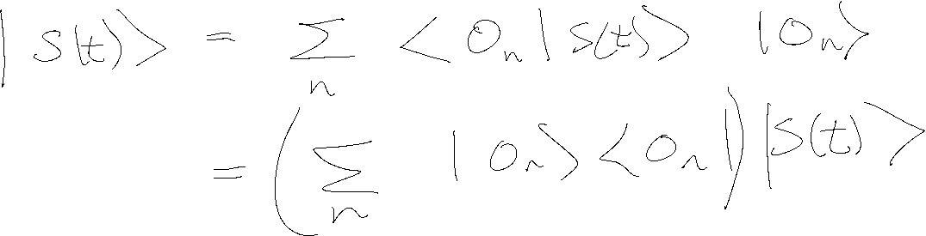
Lecture 13, Activity 1:
Notes:
So, the set of basis states look very similar to the $\left|\hat{α1}\right\rangle$and $\left|\hat{α2}\right\rangle$from the 2D vector example.,
Use this as point of departure to really hammer home this analogy.
MORE IMPORTANT, WHERE DID THE x GO? WHERE ARE THE WAVEFUNCTIONS?
WHAT WOULD YOU CHOOSE TO DEFINE THE STATE AT TIME t? {c_n IN H basis, \Psi(x<0)?, \Phi(k,0), or in some OTHER Obervable’s eigen states?) POINT IS, YOU CAN CHOOSE ANY OF THEM, SO GENERALLY CAN KEEP EQUATIONS GENERAL, IN DIRAC NOTATION, WITHOUT SPECIFYING A PARTICLAR REPRESENTATION, UNTIL YOU START ACTUALLY SOLVING A SPECIFIC PROBLEM, AT WHICH POINT THERE MAY BE A “NATURAL REPRESENTATION” TO CHOOSE. OFTEN, WHEN GET DOWN TO NITTY – GRITTY, END UP USING \Psi(x,0) IN ANALOGY TO \hat I, \hat j.

Slide 11
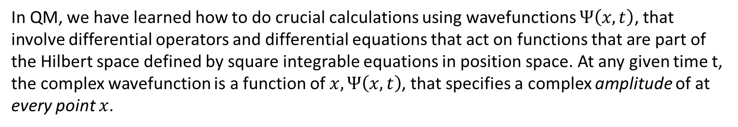
Lecture 13, Activity 2:
In 2D real vector space, learned all the manipulations in the $|\hat{i}⟩$ and $|\hat{j}⟩$ basis, before introducing other, more general orthonormal bases, $\left|\hat{α1}\right\rangle$and $\left|\hat{α2}\right\rangle$.
In QM, we have learned how to do crucial calculations using wavefunctions $Ψ\left(x,t\right)$, that involve differential operators and differential equations that act on functions that are part of the Hilbert space defined by square integrable equations in position space. At any given time t, the complex wavefunction is a function of $x, Ψ\left(x,t\right)$, that specifies a complex amplitude of at every point $x$.
What is the relationship between $Ψ\left(x,t\right)$ and $\left|S\left(t\right)\right\rangle$?
Notes:
EMPHASIZE THAT

Slide 12
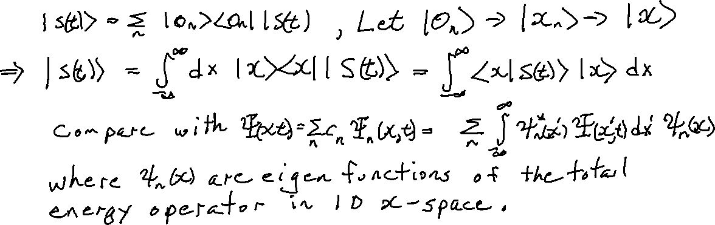
Lecture 13, Activity 2:
What is the relationship between $Ψ\left(x,t\right)$ and $\left|S\left(t\right)\right\rangle$?
Notes:
EMPHASIZE THAT

Slide 13





Lecture 13, Activity 2:
What is the relationship between $Ψ\left(x,t\right)$ and $\left|S\left(t\right)\right\rangle$?
Eigen states of the position operator in abstract Hilbert space
Eigen functions of the total energy operator in 1D x-space
Projection of the abstract state at time t in Hilbert space onto the eigen states of the position operator in abstract Hilbert space
Projection of the full wavefunction in 1D x-space onto the eigen functions of the total energy operator
Notes:
EMPHASIZE THAT

Slide 14

Lecture 13, Activity 2:
Therefore:
$$Ψ\left(x,t\right)=⟨x\left|S(t)\right\rangle$$
i.e. our wavefunction is merely the projection of the immutable state of the particle at any time t, onto eigen states of the immutable position operator with eigen values x!

Slide 15
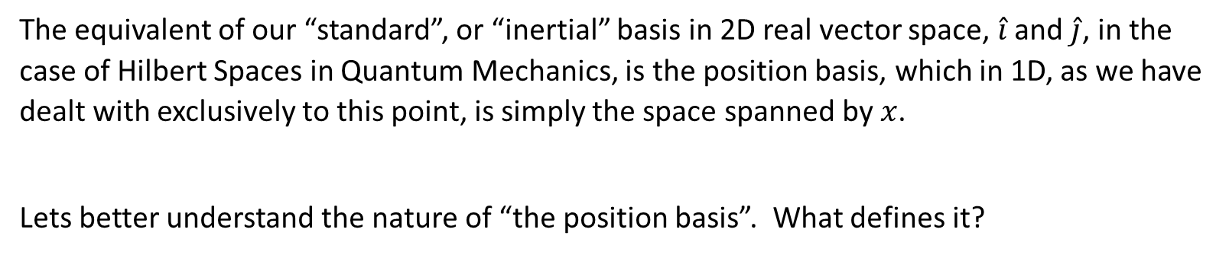
Lecture 13, Activity 3:
The equivalent of our “standard”, or “inertial” basis in 2D real vector space, $\hat{i}$ and $\hat{j}$, in the case of Hilbert Spaces in Quantum Mechanics, is the position basis, which in 1D, as we have dealt with exclusively to this point, is simply the space spanned by $x$.
Lets better understand the nature of “the position basis”. What defines it?
Notes:
Point out that in 2D vector space example, to do any actual calculations, (eg, the projection of arbitrary state onto an arbitrary alpha basis state), in practice you end up writing all the states in terms of the inertial reference frame, and then doing the dot product. In QM, fairly similar, and the usual/traditional “inertial” reference frame/basis states are {\r>}.

Slide 16






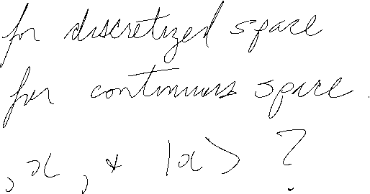


Activity Questions
Notes:
Point out that in 2D vector space example, to do any actual calculations, (eg, the projection of arbitrary state onto an arbitrary alpha basis state), in practice you end up writing all the states in terms of the inertial reference frame, and then doing the dot product. In QM, fairly similar, and the usual/traditional “inertial” reference frame/basis states are {\r>}.

Slide 17








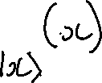


What is the wavefunction of a position operator’s eigen state?

Slide 18



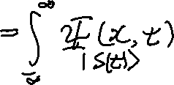






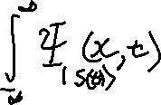




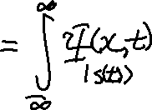
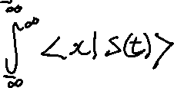




The position basis

Slide 19

















The position basis
Therefore must think of our $Ψ\left(x,t\right)$ as merely a list of (complex) projections of the more general, immutable, abstract state of the particle, $\left|S(t)\right\rangle$ onto each abstract eigen state of the immutable $\hat{x}$operator with (real) eigen values $x$.

Slide 20
Quiz

